Slide 1
מבוא לרשתות תקשורת 371.1.0291
ניתוב ברשתות
Revised 1/12/14

Slide 2

Credits
השקפים מבוססים על מצגת של:
Christo Wilson

Slide 3
Network Layer, Control Plane
המטרה:
מציאת מסלולי ניתוב בתוך רשת אחת.
הבעיות המרכזיות:
הפצה ועדכון מסלולי ניתוב.
זמן התכנסות
הימנעות מלולאות
Data Plane
Application
Presentation
Session
Transport
Network
RIP
OSPF
BGP
Control Plane
Data Link
Physical

Slide 4
Internet Routing
Internet organized as a two level hierarchy
First level – autonomous systems (AS’s)
AS – region of network under a single administrative domain
Examples: Comcast, AT&T, Verizon, Sprint, etc.
AS’s use intra-domain routing protocols internally
Distance Vector, e.g., Routing Information Protocol (RIP)
Link State, e.g., Open Shortest Path First (OSPF)
Connections between AS’s use inter-domain routing protocols
Border Gateway Routing (BGP)
De facto standard today, BGP-4

Slide 5



AS Example
AS-1
AS-3
Interior Routers
AS-2
BGP Routers

Slide 6
Why Do We Need ASs?
Routing algorithms are not efficient enough to execute on the entire Internet topology
Different organizations may use different routing policies
Allows organizations to hide their internal network structure
Allows organizations to choose how to route across each other (BGP)
Easier to compute routes
Greater flexibility
More autonomy/independence

Slide 7
Routing on a Graph
Goal: determine a “good” path through the network from source to destination
What is a good path?
Usually means the shortest path
Load balanced
Lowest $$$ cost
Network modeled as a graph
Routers → nodes
Link → edges
Edge cost: delay, congestion level, etc.
5
3
B
C
5
2
A
2
1
F
3
1
D
E
2
1

Slide 8
Routing Problems
Assume
A network with N nodes
Each node only knows
Its immediate neighbors
The cost to reach each neighbor
How does each node learn the shortest path to every other node?
5
3
B
C
5
2
A
2
1
F
3
1
D
E
2
1

Slide 9
Intra-domain Routing Protocols
Distance vector
Routing Information Protocol (RIP), based on Bellman-Ford
Routers periodically exchange reachability information with neighbors
Link state
Open Shortest Path First (OSPF), based on Dijkstra
Each network periodically floods immediate reachability information to all other routers
Per router local computation to determine full routes

Slide 10
Outline
Distance Vector Routing
RIP
Link State Routing
OSPF
IS-IS

Slide 11
Distance Vector Routing
What is a distance vector?
Current best known cost to reach a destination
Idea: exchange vectors among neighbors to learn about lowest cost paths
No entry for C
Initially, only has info for immediate neighbors
Other destinations cost = ∞
Eventually, vector is filled
Destination | Cost
A | 7
B | 1
D | 2
E | 5
F | 1
DV Table
at Node C
Routing Information Protocol (RIP)

Slide 12
Distance Vector Routing Algorithm
Wait for change in local link cost or message from neighbor
Recompute distance table
If least cost path to any destination has changed, notify neighbors

Slide 13
Distance Vector Initialization
Node A
Node B
3
B
D
Dest. | Cost | Next
B | 2 | B
C | 7 | C
D | ∞
Dest. | Cost | Next
A | 2 | A
C | 1 | C
D | 3 | D
2
1
1
A
7
C
Initialization:
for all neighbors V do
if V adjacent to A
D(A, V) = c(A,V);
else
D(A, V) = ∞;
…
Node D
Node C
Dest. | Cost | Next
A | 7 | A
B | 1 | B
D | 1 | D
Dest. | Cost | Next
A | ∞
B | 3 | B
C | 1 | C

Slide 14
Distance Vector: 1st Iteration
Node A
Node B
3
B
D
Dest. | Cost | Next
B | 2 | B
C | 7 | C
D | ∞
Dest. | Cost | Next
A | 2 | A
C | 1 | C
D | 3 | D
2
1
1
3
B
A
7
C
5
8
C
B
2
C
…
loop:
if (update D(V, Y) received from V)
for all destinations Y do
D(A, Y) =min(D(A, Y),
D(A, V) + D(V, Y));
if (there is a new min. for dest. Y)
send D(A, Y) to all neighbors
forever
D(A,C) = min(D(A,C), D(A,B)+D(B,C))
= min(7, 2 + 1) = 3
Node C
Node D
D(A,D) = min(D(A,D), D(A,B)+D(B,D))
= min(8, 2 + 3) = 5
D(A,D) = min(D(A,D), D(A,C)+D(C,D))
= min(∞, 7 + 1) = 8
Dest. | Cost | Next
A | 7 | A
B | 1 | B
D | 1 | D
Dest. | Cost | Next
A | ∞
B | 3 | B
C | 1 | C
3
B
4
B

Slide 15
Distance Vector: End of 3rd Iteration
Node A
Node B
3
B
D
Dest. | Cost | Next
B | 2 | B
C | 3 | B
D | 4 | B
Dest. | Cost | Next
A | 2 | A
C | 1 | C
D | 2 | C
2
1
1
A
7
C
…
loop:
…
else if (update D(V, Y) received from V)
for all destinations Y do
if (destination Y through V)
D(A, Y) =min(D(A, Y),
D(A, V) + D(V, Y));
if (there is a new min. for dest. Y)
send D(A, Y) to all neighbors
forever
Nothing changes, algorithm terminates
Until something changes…
Node C
Node D
Dest. | Cost | Next
A | 3 | B
B | 1 | B
D | 1 | D
Dest. | Cost | Next
A | 4 | C
B | 2 | C
C | 1 | C

Slide 16
loop:
wait (link cost update or update message)
if (c(A,V) changes by d)
for all destinations Y through V do
D(A,Y) = D(A,Y) + d
else if (update D(V, Y) received from V)
for all destinations Y do
D(A, Y) = min(D(A, Y), D(A, V) + D(V, Y));
if (there is a new minimum for destination Y)
send D(A, Y) to all neighbors
forever
B
4
1
1
A
50
C
Link Cost Changes,
Algorithm Starts
Algorithm Terminates
Good news travels fast
D | C | N
A | 4 | A
C | 1 | B
D | C | N
A | 1 | A
C | 1 | B
D | C | N
A | 1 | A
C | 1 | B
D | C | N
A | 1 | A
C | 1 | B
Node B
D | C | N
A | 5 | B
B | 1 | B
D | C | N
A | 5 | B
B | 1 | B
D | C | N
A | 2 | B
B | 1 | B
D | C | N
A | 2 | B
B | 1 | B
Node C
Time
Notes:
Change circles to rectangles, don’t block the text

Slide 17
Count to Infinity Problem
Node B knows D(C, A) = 5
However, B does not know the path is C → B → A
Thus, D(B,A) = 6 !
B
4
60
1
A
C
Bad news travels slowly
50
D | C | N
A | 4 | A
C | 1 | B
D | C | N
A | 6 | C
C | 1 | B
D | C | N
A | 6 | C
C | 1 | B
D | C | N
A | 8 | C
C | 1 | B
Node B
D | C | N
A | 5 | B
B | 1 | B
D | C | N
A | 5 | B
B | 1 | B
D | C | N
A | 7 | B
B | 1 | B
D | C | N
A | 7 | B
B | 1 | B
Node C
Time

Slide 18
Poisoned Reverse
If C routes through B to get to A
C tells B that D(C, A) = ∞
Thus, B won’t route to A via C
B
4
60
1
Does this completely solve this count to infinity problem?
NO
Multipath loops can still trigger the issue
A
50
C
D | C | N
A | 4 | A
C | 1 | B
D | C | N
A | 60 | A
C | 1 | B
D | C | N
A | 60 | A
C | 1 | B
D | C | N
A | 51 | C
C | 1 | B
Node B
D | C | N
A | 5 | B
B | 1 | B
D | C | N
A | 5 | B
B | 1 | B
D | C | N
A | 50 | A
B | 1 | B
D | C | N
A | 50 | A
B | 1 | B
Node C
Time

Slide 19
Outline
Distance Vector Routing
RIP
Link State Routing
OSPF
IS-IS

Slide 20
Link State Routing
Each node knows its connectivity and cost to direct neighbors
Each node tells every other node this information
Each node learns complete network topology
Use Dijkstra to compute shortest paths

Slide 21
Flooding Details
Each node periodically generates Link State Packet
ID of node generating the LSP
List of direct neighbors and costs
Sequence number (64-bit, assumed to never wrap)
Time to live
Flood is reliable (ack + retransmission)
Sequence number “versions” each LSP
Receivers flood LSPs to their own neighbors
Except whoever originated the LSP
LSPs also generated when link states change

Slide 22
Dijkstra’s Algorithm
Step | Start S | →B | →C | →D | →E | →F
0 | A | 2, A | 5, A | 1, A | ∞ | ∞
1 | AD |  | 4, D |  | 2, D | ∞
2 | ADE |  | 3, E |  |  | 4, E
3 | ADEB
4 | ADEBC
5 | ADEBCF
5
…
Loop
find w not in S s.t. D(w) is a minimum;
add w to S;
update D(v) for all v adjacent
to w and not in S:
D(v) = min( D(v), D(w) + c(w,v) );
until all nodes in S;
3
Initialization:
S = {A};
for all nodes v
if v adjacent to A
then D(v) = c(A,v);
else D(v) = ∞;
…
B
C
5
2
A
2
1
F
3
1
2
D
E
1

Slide 23
OSPF vs. IS-IS
Two different implementations of link-state routing
OSPF
IS-IS
Favored by companies, datacenters
More optional features
Built on top of IPv4
LSAs are sent via IPv4
OSPFv3 needed for IPv6
Favored by ISPs
Less “chatty”
Less network overhead
Supports more devices
Not tied to IP
Works with IPv4 or IPv6

Slide 24
Different Organizational Structure
OSPF
IS-IS
Organized around overlapping areas
Area 0 is the core network
Organized as a 2-level hierarchy
Level 2 is the backbone
Area 1
Area 2
Level 1
Level 1-2
Level 2
Area 0
Area 4
Area 3

Slide 25
Link State vs. Distance Vector
 | Link State | Distance Vector
Message Complexity | O(n²*e) | O(d*n*k)
Time Complexity | O(n*log n) | O(n)
Convergence Time | O(1) | O(k)
Robustness | Nodes may advertise incorrect link costs Each node computes their own table | Nodes may advertise incorrect path cost Errors propagate due to sharing of DV tables
Which is best?
In practice, it depends.
In general, link state is more popular.
n = number of nodes in the graph
d = degree of a given node
k = number of rounds

Slide 26
Outline
BGP Basics
Stable Paths Problem
BGP in the Real World
Next-gen Routing: HLP

Slide 27
ASs, Revisited
AS-1
AS-3
Interior Routers
AS-2
BGP Routers

Slide 28
AS Numbers
Each AS identified by an ASN number
16-bit values
64512 – 65535 are reserved
Currently, there are > 20000 ASNs
AT&T: 5074, 6341, 7018, …
Sprint: 1239, 1240, 6211, 6242, …
Northeastern: 156
North America ASs → ftp://ftp.arin.net/info/asn.txt

Slide 29
Inter-Domain Routing
Global connectivity is at stake!
Thus, all ASs must use the same protocol
Contrast with intra-domain routing
What are the requirements?
Scalability
Flexibility in choosing routes
Cost
Routing around failures
Question: link state or distance vector?
Trick question: BGP is a path vector protocol

Slide 30
BGP
Border Gateway Protocol
De facto inter-domain protocol of the Internet
Policy based routing protocol
Uses a Bellman-Ford path vector protocol
Relatively simple protocol, but…
Complex, manual configuration
Entire world sees advertisements
Errors can screw up traffic globally
Policies driven by economics
How much $$$ does it cost to route along a given path?
Not by performance (e.g. shortest paths)

Slide 31
BGP Relationships
Provider
Peer 2 has no incentive to route 1→ 3
Peers do not pay each other
Customer
Provider
Customer
Peer 1
Peer 2
Peer 3
Customer pays provider
Customer

Slide 32
Tier-1 ISP Peering
Inteliquent
Centurylink
Verizon Business
AT&T
Level 3
Sprint
XO Communications

Slide 33
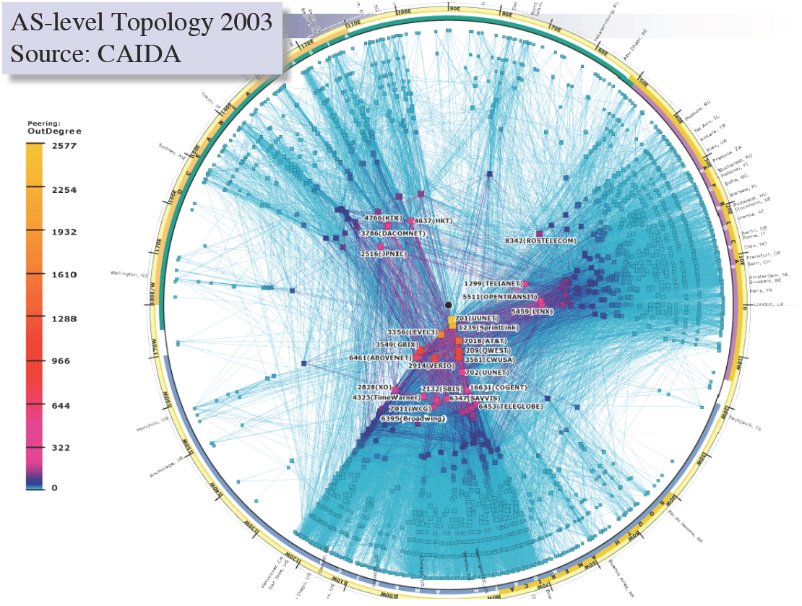

Slide 34
Peering Wars
Peer
Don’t Peer
Reduce upstream costs
Improve end-to-end performance
May be the only way to connect to parts of the Internet
You would rather have customers
Peers are often competitors
Peering agreements require periodic renegotiation
Peering struggles in the ISP world are extremely contentions, agreements are usually confidential

Slide 35
BGP Sub-Operations
eBGP: obtain subnet reachability information from neighboring Ass and sending reachability to other AS’s.
iBGP: propagate reachability information to all AS-internal routers.
when router learns of new prefix, it creates entry for prefix in its forwarding table. New update iBGP to the AS routers is sent.

Slide 36
Two Types of BGP Neighbors
Exterior routers also speak IGP
IGP
eBGP
eBGP
iBGP
iBGP

Slide 37
Full iBGP Meshes
Question: why do we need iBGP?
OSPF does not include BGP policy info
Prevents routing loops within the AS
eBGP
iBGP

Slide 38
Path Vector Protocol
AS-path: sequence of ASs a route traverses
Like distance vector, plus additional information
Used for loop detection and to apply policy
Default choice: route with fewest # of ASs
AS 4
120.10.0.0/16
AS 3
130.10.0.0/16
AS 5
AS 2
110.10.0.0/16
120.10.0.0/16: AS 2 → AS 3 → AS 4
130.10.0.0/16: AS 2 → AS 3
110.10.0.0/16: AS 2 → AS 5
AS 1

Slide 39
BGP Operations (Simplified)
Establish session on TCP port 179
AS-1
Exchange active routes
BGP Session
AS-2
Exchange incremental updates

Slide 40
Four Types of BGP Messages
Open: Establish a peering session.
Keep Alive: Handshake at regular intervals.
Notification: Shuts down a peering session. reports errors in previous msg; also used to close connection
Update: Announce new routes or withdraw previously announced routes.
announcement = IP prefix + attributes values

Slide 41
BGP Attributes
Attributes used to select “best” path
LocalPREF
Local preference policy to choose most preferred route
Overrides default fewest AS behavior
Multi-exit Discriminator (MED)
Specifies path for external traffic destined for an internal network
Chooses peering point for your network
Import Rules
What route advertisements do I accept?
Export Rules
Which routes do I forward to whom?

Slide 42
Route Selection Summary
Highest Local Preference
Enforce relationships
Shortest AS Path
Lowest MED
Traffic engineering
Lowest IGP Cost to BGP Egress
When all else fails,
break ties
Lowest Router ID

Slide 43
Shortest AS Path != Shortest Path
4 hops
4 ASs
9 hops
2 ASs
Source
?
?
Destination

Slide 44
Hot Potato Routing
5 hops total, 2 hops cost
Source
3 hops total,
3 hops cost
?
?
Destination

